Slide 1
International education: the national imperatives
Grant McPherson
Education New Zealand

Slide 2
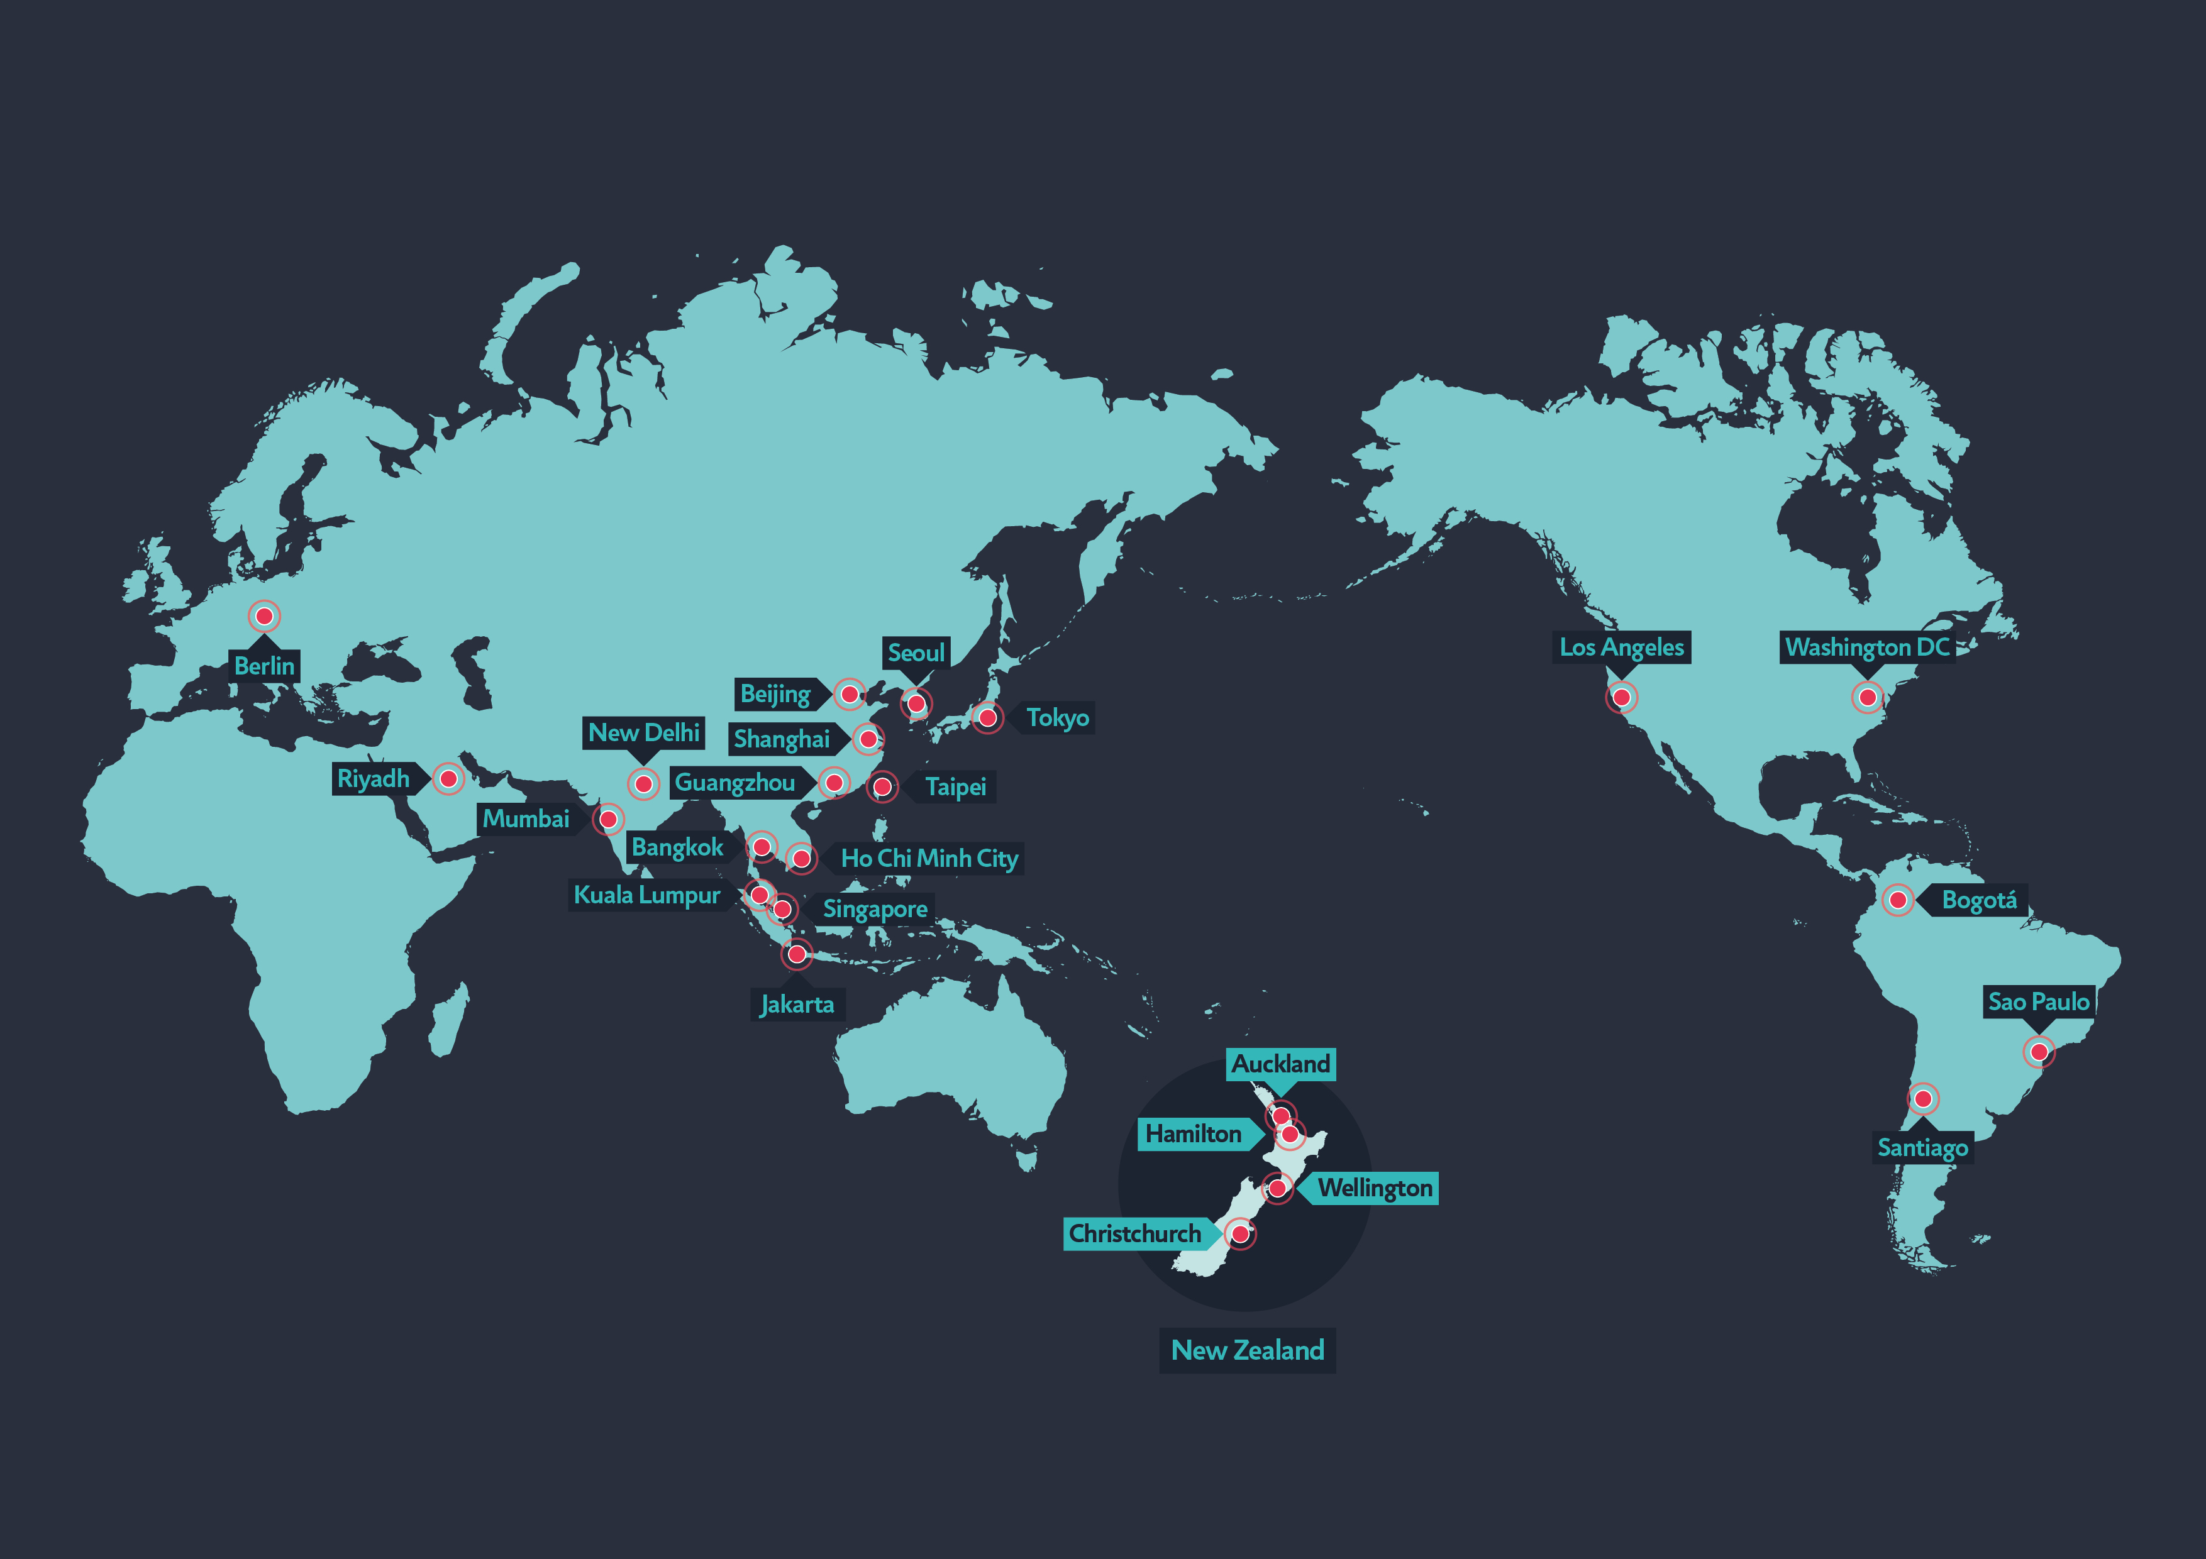
Education New Zealand
Notes:
Introduce yourself, Education New Zealand.
Education New Zealand, the New Zealand Government’s agency for international education, has more than 70 staff around the world, including a head office in Wellington and offices in Christchurch, Auckland and Hamilton.

Slide 3



Why international education?
Brings economic growth to communities in New Zealand
Increases the links between New Zealanders and the world
Supports more than 30,000 jobs
Helps attract highly skilled migrants
Delivering education services offshore generates over $100m
Education providers received over $880 m in fees in 2014
Produces over 110,000 brand ambassadors for New Zealand
Notes:
Why international education?
[Rather than reading off the screen, as the audience will do this while you’re speaking, perhaps could tell an anecdote from your recent trip to the States, or Viet Nam, or China that illustrates some of these points.]

Slide 4










At a glance – industry value
At 2.85 billion, international education is New Zealand’s fifth largest export industry – and it’s growing.
$15.83b
$7.14b
$5.64b
$4.02b
$2.85b
$1.99b
$1.68b
$1.55b
$1.40b
$1.33b
Milk powder, butter, & cheese
Business & other travel
Logs, wood, & wood articles
Fruit
Mechanical machinery & equipment
Crude oil
Wine
Meat & edible offal
International education
Air transport
$5bn
Notes:
International education is valuable to New Zealand.
Many people don’t know it’s New Zealand’s fifth largest export industry, it supports 30,000 jobs and it’s growing.
Education New Zealand is working with New Zealand’s international education industry to grow the economic contribution of international education from $2.85 billion to $5 billion dollars by 2025.

Slide 5


At a glance – industry breakdown
Total contribution of international education
$2.85b
Total value of expenditure by international students $2.75b
Total value of offshore activity1 $0.104b
Notes:
New Zealand’s international education industry includes both international students studying in New Zealand and those enrolled with New Zealand institutions overseas.
It also includes the export of education products and other educational services – that’s a big area of opportunity in the States, with our innovative tech companies meeting like-minded innovators.
Our goals are across three parts of this industry
Student attraction
International delivery
Working for New Zealand – New Zealand makes the best possible use of its international expertise to build skills in our workforce, grow our research capability and build wider economic connections.

Slide 6


USA: Why international education?
Current US administration views study abroad as ‘an issue of national security’ and a ‘national imperative’
IIE Generation Study Abroad (GSA) initiative to double number of study abroad students by 2020
Newly created US Department of State Study Abroad Office
Notes:
Reminder: Melanie Higgins (US Consul General) will have talked about annual student mobility figures from the Open Doors Report prior.
According to latest figures, 289,400 US students studied abroad in 2012/13 and the 2,500 students which study in New Zealand are 1% of that market. New Zealand is ranked number 23 in leading destinations for US students – UK is ranked 1, Italy 2, and Spain 3 – down from 13 in 2003/04. Until mid-2012 NZ had no market development focus on the USA.
The 289,000 American students that studied abroad in the US 2012/13 academic year represent 1.5 percent of the almost 20 million American students enrolled in higher education programs at any given time. Half of U.S. students enter university planning to study abroad, but fewer than 10 percent do.
Also, since the 1980s the number of US students studying abroad has doubled each decade – except for this one. It slowed from the onset of the Global Financial Crisis – studying overseas is expensive.
However, the US administration doesn’t view this slow down as acceptable. In a March speech at the Forum on Education Abroad, Evan Ryan, Assistant Secretary of State said, “We can – and must – do better.”
She also said, “…we believe that encouraging American students to study abroad is in their best interest and is a strategic imperative for the United States. President Obama and Secretary Kerry are both strong advocates for the value and importance of education abroad.” and “It’s an issue of national competitiveness, really. We want to make sure that the future leaders of our country are globally competent, and internationally savvy.”
So, the State Department is committed to increasing the numbers of US students abroad. And, as part of efforts do that, they’ve committed as a government partner to the Institute of International Education’s (IIE) Generation Study Abroad (GSA) initiative, launched in 2014 to double the number of students who study abroad by 2020.
Just to remind you, 289,000 students studied abroad in 2012/13, so that’s 600,000 students by 2020. To put that in context, in 2014, China sent about 460,000 students abroad in 2014.
To date, 630 partners have joined the initiative, including 400 US colleges and universities, 100 international universities and organisations, 14 governments (including New Zealand– ENZ committed as a partner in April last year), 25 education associations, and 100 US study abroad organisations. To date, 450 teachers have pledged to be study abroad advocates in schools.

Slide 7

USA: Study Abroad Office
Aims to:
    increase numbers of US study abroad students
    diversify the population of students studying abroad
    diversify where students study overseas
    build partnerships with foreign governments
Office is developing:
    new campaign to promote study abroad
    new digital platform to promote specific opportunities
    ‘capacity building’ grants
Notes:
Reminder: Melanie Higgins (US Consul General) will have talked about annual student mobility figures from the Open Doors Report prior.
The State Department has also recently launched the “Study Abroad Office”.
The Office will push for diversity among study abroad participants, promote non-traditional destinations and build partnerships with foreign governments (which is an opportunity for ENZ).
Capacity-Building Program for US Undergraduate Study: provides institutional grants to U.S. colleges and universities looking to create or expand their study abroad programs, particularly for underrepresented student audiences or non-traditional study abroad destinations. Opportunity for NZ institutions to partner with US institutions to develop new programmes which will attract this funding.

Slide 8


USA: the numbers
2,465 students enrolled in 2014, ↓3%
on 2013
BUT significant growth 2015 ↑23% in FSVs
A tertiary market: 79% of US students enrol in bachelor-level study, 4% masters, 12% PhD
Significant opportunity – NZ receives only 1% of the market
Notes:
Reminder: Melanie Higgins (US Consul General) will have talked about annual student mobility figures from the Open Doors Report prior.
So to NZ’s numbers:
In 2014, the US was New Zealand’s ninth largest student attraction market, with 2,465 US students enrolled with New Zealand providers, which was a 3 percent decline on 2013.
Reasons for decline: Christchurch earthquakes, strong New Zealand dollar, and lack of profile.
In 2015, we have seen significant growth in first time student visas (FSVs) held by US students, up 23% YTD, and enrolments across Jan-Aug this year are up 9% on (220 enrolments) on 2014.
I’ll talk more about what’ve been doing in the States and will be doing there again in a moment. Overall though, we seen great opportunity between the US and NZ in international education and we’re increasing our activities and investment accordingly.

Slide 9


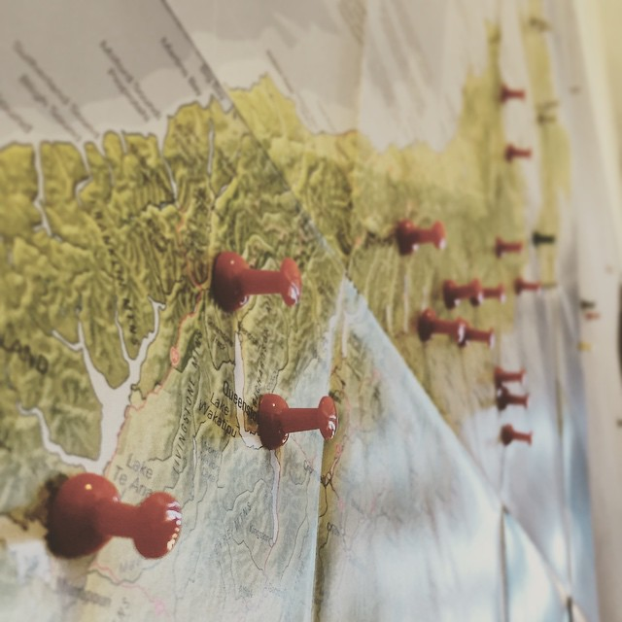
USA: the numbers
Universities’ second-largest market (to China) in 2014
Largest universities market in Semester One of 2015
The number of US students at ITPs and PTEs increasing too.
Notes:
Up on this slide are couple of interesting facts and figures you might not know -
The US is an important source of fee paying students into NZ universities. 88 percent of US students enrolled in NZ institutions are studying at a university. The large majority of US students – around 85 percent – arrive on Study Abroad programmes, accruing academic credit towards their US degrees, typically for a semester or less in duration.
From an admittedly low base, we’ve seen growth to both ITPs and PTEs this year which reflects the growth to the universities.

Slide 10
USA: HOME STATES
Notes:
Another interesting fact: the bulk of US study abroad students come from the Northeast (large numbers of US universities in the Northeast), Colorado, the Northwest and California (because of students who love the outdoors); numbers from Texas are increasing.
It’s quite a different location profile to our trade activities with the US.

Slide 11
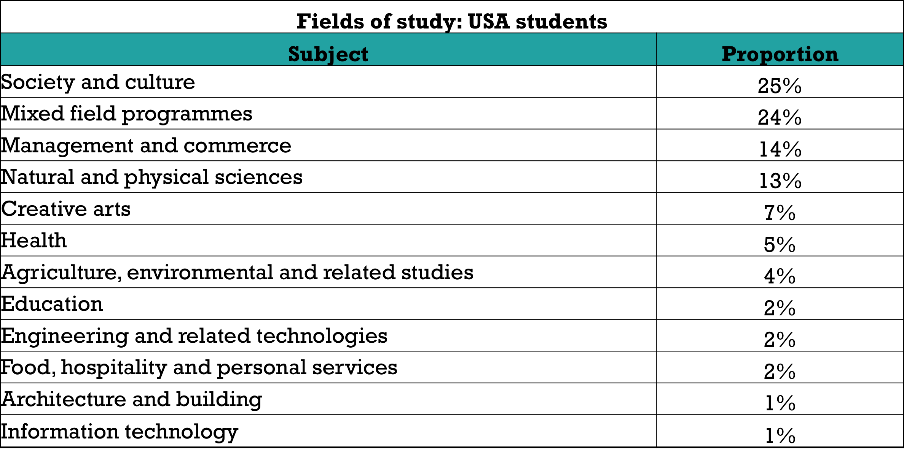
USA: FIELDS OF STUDY IN NZ
Notes:
Here’s what students study while they’re here.
It fits pretty well with Top Fields of Study according to the Open Doors report:
STEM: 22.5% (↑8.8% 2012/13 vs. 2011/12)
Social Sciences: 22.1% (↑0.8%)
Business: 20.4% (↑1.8%)
Humanities: 10.4% (↓1.6%)
Fine or Applied Arts: 7.8% (↑2.4%)
Foreign Languages: 4.9% (↓5.5%)
Education: 4% (↑ 0.2%)
Undeclared: 2.7% (↓7.8%)
Other fields of study: 5.2% (↑4.5%)

Slide 12


USA: STUDENT DISTRIBUTION
Auckland 31%
Auckland 31%
Waikato 7%
Waikato 7%
Manawatu/Wanganui 5%
Manawatu/Wanganui 5%
Wellington 16%
Wellington 16%
Canterbury 15%
Canterbury 15%
Otago 25%
Otago 25%
Notes:
And here’s where they go. This is quite a different profile to the national picture – nationally, 62% of all international students study in Auckland.

Slide 13
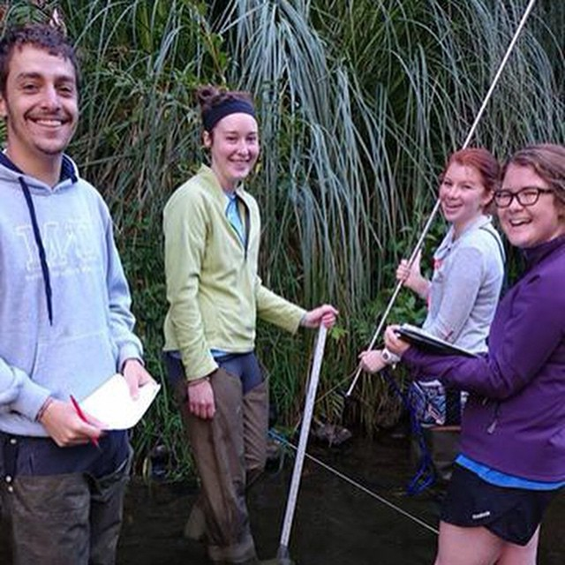

USA: ENZ market support
‘Promote’ market for ENZ
Go Overseas campaign – three year commitment (after 2014 pilot)
Government partner to IIE GSA initiative
    Study Abroad scholarships
    Virtual US Study Abroad Fair (Feb ‘15)
    Host reception at IIE Summit on GSA
  NAFSA
Notes:
So, what is ENZ is doing to support the initiatives of the US administration in a way that aligns with NZ’s objectives?
The US is now a ‘promote’ market for ENZ. This means that ENZ is working to increase the profile of New Zealand as an education destination in the States; we’re going to support NZ’s international education industry to enter the market and support opportunities for institutions who are already there. We’ll have a strategic focus there over the coming years.
Last year, we partnered with US online study abroad advisory service Go Overseas (the ‘Trip Advisor’ of the study abroad world) for a six week campaign spanning September/October last year, offering one NZ$15,000 scholarship for one semester of study. STA Travel offered return flight. Go Overseas promoted through study abroad channels (incl. 1,500 universities and 2,600+ study abroad staff), a campaign website and social media. There were 46,300 page views, and 1,089 students submitted an application.
This campaign proved so successful in raising the profile of New Zealand as an education destination that ENZ has committed to working with Go Overseas for a further three years. The 2015 campaign launched 1 September – and this year the 2015 campaign received 2,361 applications for the scholarship, more than double the 1,089 applications received in 2014, and next semester a finance student arrives for a semester at Auckland University.
I mentioned earlier that ENZ is a government partner under the IIE GSA initiative. As part of the commitment:
ENZ partnered with New Zealand universities and a number of ITPs to offer study abroad scholarships to US students. Universities and participating ITPs funded US$500 tuition or living costs awards, and ENZ provided matched funding in the form of US$2,000 travel awards to help students pay for their flight to New Zealand. 14 students received awards for semester 1 2015 (February – June), and 11 students have received awards in semester 2 (July – November).
ENZ participated in the first IIE and State Department Virtual US Study Abroad Fair, which took place in February. There were over 3,000 attendees as well as 50 exhibitors, and the New Zealand booth was in the top 10 percent of visited booths.
ENZ hosted a reception at the New Zealand Embassy in Washington DC during the first IIE Summit on Generation Study Abroad in October.
ENZ coordinates the New Zealand presence at NAFSA, the largest international education conference in the world (in 2015 there were 11,500 delegates from all over the world) which takes place in the US each May.

Slide 14


USA: strategic focus
Appoint in-market
Leverage State Dept and IIE GSA objectives to increase study abroad
    Target: 20 percent y-o-y growth
Raise profile with study abroad providers and advisors
Long term: diversify beyond traditional study abroad (postgraduate, ITPs, PTEs); diversify sending institutions
Notes:
Our future focus is to:
Leverage State Dept and IIE GSA objectives to increase study abroad, work with State Dept to increase numbers of US students in NZ. Our target growth, fitting with the US being a promote market, is 20% growth year-on-year.
Work more closely with the large study abroad providers, like ISA, TEAN, Arcadia and the Institute for Study Abroad. Working with the study abroad providers will leverage their huge networks throughout the study abroad community to build New Zealand’s profile. The Go Overseas campaign and the IIE GSA commitment will help raise profile with study abroad advisors.
Long term diversification of the level of student study. The State Dept aims to increase numbers of students who study overseas at all levels. 16% of New Zealand’s US students study at postgraduate level. The trend of postgraduate enrolment tends to lag behind study abroad, and to date 2015, renewed student visas – a good indicator of postgrad numbers as they reflect students “in the pipeline” – are down 8%. I think New Zealand will continue to see a decreasing number of postgraduate enrolments in 2015/16 FY. However, the work to increase the profile of New Zealand on US campuses will drive postgraduate numbers up longer term.
Increased air links will help – Air New Zealand’s new Houston route, and American Airlines new daily LA to Auckland route.
Unlike Australia, New Zealand doesn’t offer study abroad students work rights. Even if it’s not taken up, the possibility of working while study is attractive to students. You can see that in the demand for one-year working holiday visas which are snapped up quickly. Often by former Study Abroad students wanting to come back to NZ.

Slide 15

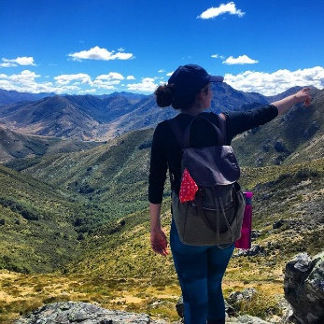
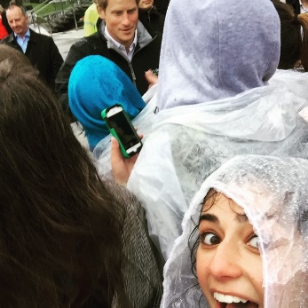

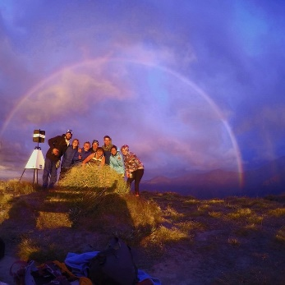

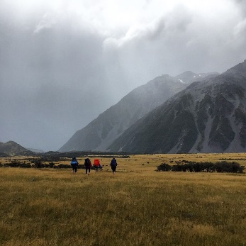

USA: social media
Instagram page created in March, content provided by US IIE GSA scholarship students – now has over 7,100 followers
Notes:
You will have seen lovely pictures throughout my presentation. As part of ENZ’s social media presence, we created an Instagram page in March.
Students who received awards in the first round of the IIE GSA scholarships (who have now returned to the U.S.) were recruited as ‘Kiwi Ambassadors’ to provide content (photos and video) for the page. There are now over 3,150 followers on the page, and you can see some of the fantastic photos they uploaded here.
The value of Instagram is that it creates a platform for students to tell an authentic story of their experiences in New Zealand – the images and comments come from them, not us. It’s valuable when selling New Zealand as an authentic destination for US students – so make sure you follow us, too! Instagram.com/studyinnewzealand

Slide 16
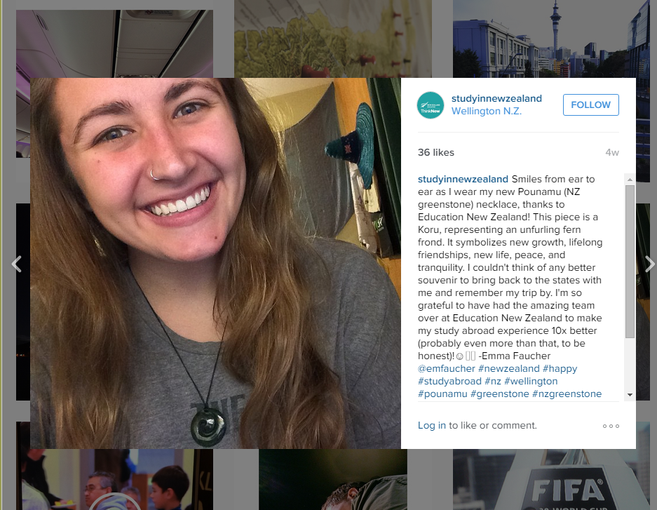
USA: social media
Emma Faucher
Go Overseas campaign pilot scholarship winner
Notes:
This is another image from Instagram, uploaded by Emma Faucher (fo-shay), the recipient of the inaugural Go Overseas scholarship. She studied at Victoria University of Wellington, and will – forever – be a vocal advocate for studying in New Zealand. Her caption on Instagram reads (she was also recruited as a ‘Kiwi Ambassador’):
“Smiles from ear to ear as I wear my new Pounamu (NZ greenstone) necklace, thanks to Education New Zealand! This piece is a Koru, representing an unfurling fern frond. It symbolizes new growth, lifelong friendships, new life, peace, and tranquillity. I couldn't think of any better souvenir to bring back to the states with me and remember my trip by. I'm so grateful to have had the amazing team over at Education New Zealand to make my study abroad experience 10x better (probably even more than that, to be honest)!☺️🇳🇿 -Emma Faucher @emfaucher #newzealand#happy #studyabroad #nz #wellington#pounamu #greenstone #nzgreenstone#jade #necklace #nofilter #nzstudyabroad#gifts #souvenir #koru #memories #peace#tranquility #newgrowth #newlife#lifelongfriendships”

Slide 17

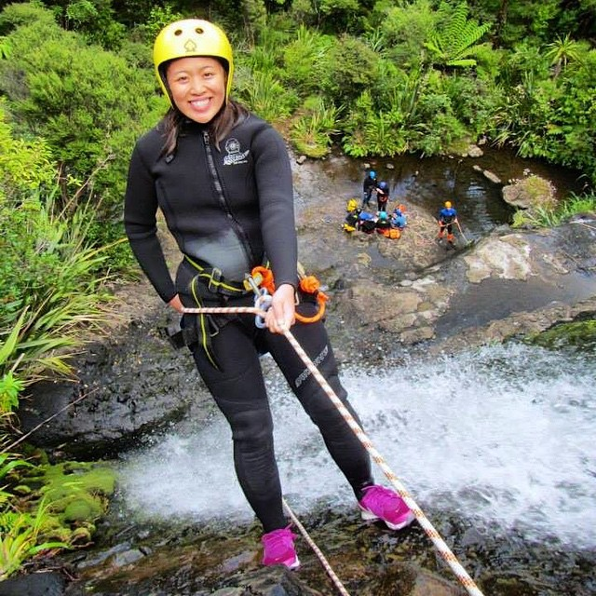

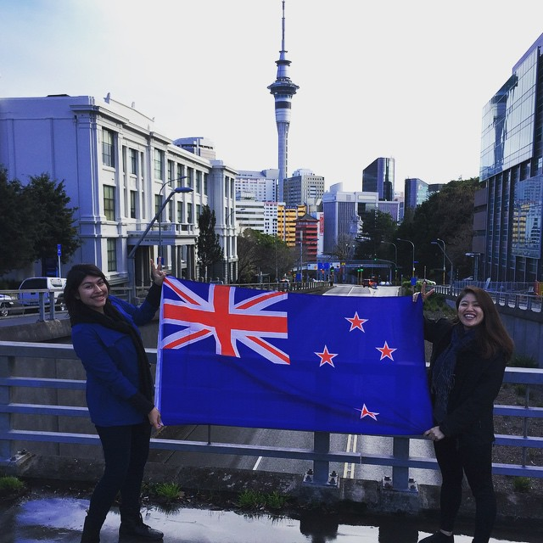
USA: NZ Inc
Align with Tourism New Zealand, as study abroad students choose NZ for the same reason as tourists
Collaborate with NZTE around edtech, education business and education publishing opportunities
WOW: Leverage NZ companies’ in-market presence
Help us tell the ‘New Zealand Education Story’
Notes:
US study abroad students tend to choose New Zealand for the same reasons tourists do (they love getting out about, experiencing all that New Zealand has to offer). Aligning with Tourism, particularly around the short-term study abroad market, is a opportunity.
WOW: The World of Wearable Arts has developed a museum exhibition which will start touring the US next year. I’m hopeful we’ll be able to work with WOW, for example, to leverage their presence in the US to increase the profile of NZ design-focused institutions (e.g., CoCA at Massey, Whitecliffe, etc). We are also looking for other opportunities to leverage NZ companies’ presence in-market.
When you travel, keep telling the story of New Zealand education, as well as our amazing tourism experiences, and products.

Slide 18
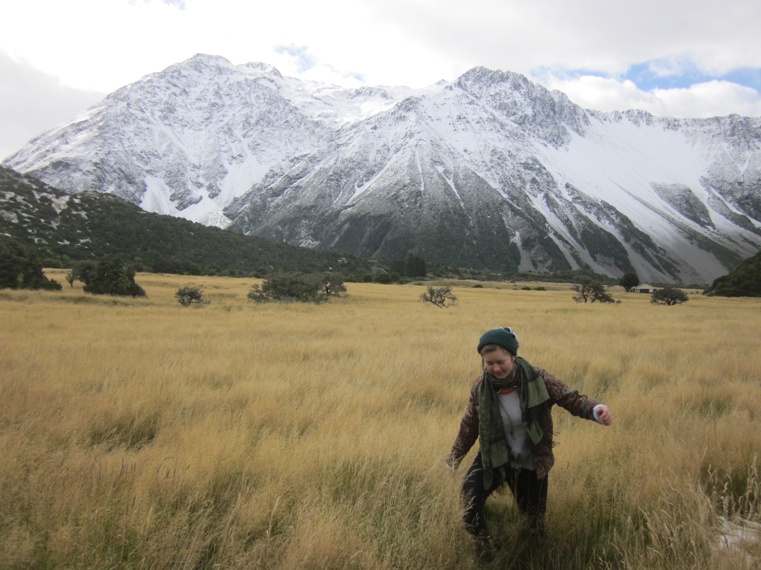
USA: thanks
“Thanks for the opportunity!
My time in New Zealand was
a life-changing experience.”
Kora Nixon
University of Waikato/Michigan State University,
IIE GSA scholarship recipient
Notes:
This is a picture by Kora Nixon, who received an IIE GSA award to study in semester one, 2015. She also received a prize at the end of the semester from ENZ to reward her for submitting such great pictures during her time at the University of Waikato.
We are focusing on and encouraging education providers to focus on:
Delivering a great student experience, and delivering the types of programmes students want and the experiences they need.
Using targeted scholarships to support students and raise awareness of New Zealand.
Programme development is vitally important. It’s no longer enough to just offer direct enrol programmes, US institutions are looking for added value. VUW’s International Leadership Programme and Otago’s Job Ready Programme are examples of programmes that have been developed for international students which could (and have, I think) be easily expanded to study abroad students. What do you already offer that you can repackage for the US market?
US universities (particularly small, expensive liberal arts colleges, where the sticker price now regularly exceeds $60,000 a year) are experts at maximising student experience, and of developing programmes that ‘add value’ to a student’s education. They constantly look to develop programmes (like short-term faculty-led study abroad, niche offerings, community engagement/volunteerism, etc.) to demonstrate their value to potential students, to justify their cost, and to invest their students in their university for the rest of their life.
They’re experts at creating a campus culture. Your US university isn’t just somewhere you went, it’s something you are present tense. You’re a Richmond Spider whether you currently attend the University of Richmond, or attended it 50 years ago. You’re an Ohio State Buckeye. You’re an Oberlin College Yeowoman or Yeoman. Forever.
Our education providers are competing with this campus culture (the football games, sororities, the feeling of belonging that comes with going to a US college) when recruiting student. They need to recognise this in their marketing and recruitment in the States, and this is why they need to create those niche programmes and opportunities that students can’t get at their home university.
They also need to create opportunities to develop a similar feeling of that culture for your students while they’re in NZ, so they can take it back to their home campuses and be ambassadors on our behalf. We also encourage them to stay connected to their alumni.
Small scholarships: the way that US students fund their studies (both home and abroad) is enormously complex. Because students stitch together funding from their parents, university financial aid, state and federal aid and other sources of scholarships to fund their college tuition, offering small scholarships to students is an inexpensive way to raise your profile (you can see the impact the scholarships had this year at a time the New Zealand dollar was at its height against the US Dollar – a 23 percent increase). Targeting those scholarships – to first generation college students/HBCs/diversity – leverages US universities’ own objectives is a useful way for you.

