Slide 1
Facilitating Business Investment in the United States SelectUSA
Seth Isenberg
Senior International Investment Specialist
SelectUSA
Tel: +1 202 482 0588
E-mail: Seth.Isenberg@trade.gov
November 2015

Slide 2
Introduction
Notes:
FDI Trends Transition

Slide 3
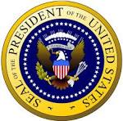
Interagency Investment Working Group
The Executive Order establishes the
Federal Interagency Investment Working Group (IIWG)
“The Working Group shall coordinate activities to promote business investment and respond to specific issues that affect business investment decisions”
Over 20 IIWG participating Agencies, including:
Department of State
DHS
SBA
Ex-Im Bank
USTR
DOE
DOD
Notes:
The Executive Order outlines:
The Administration’s policy on business investment
The establishment and functions of the SelectUSA Initiative

Slide 4
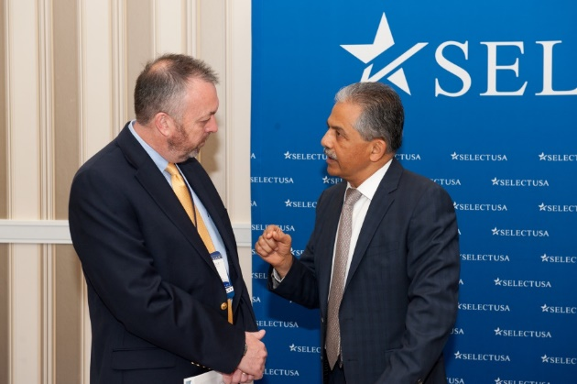
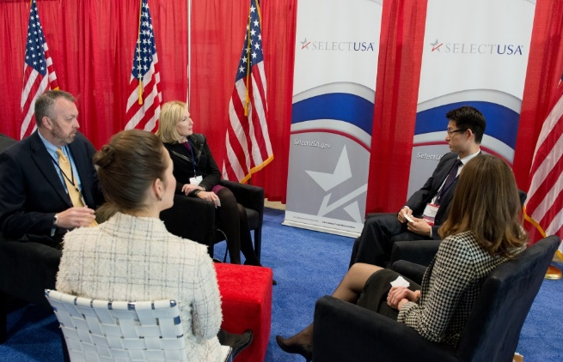
What is SelectUSA?
SelectUSA’s mission is to promote and facilitate business investment in the United States.
We serve two Clients:
Companies (investors)
U.S. States, Regions, and Cities
We deliver results: From FY15Q1- FY15Q3, SelectUSA Clients announced 49 projects totaling $4.1 Billion, accounting for an estimated 11,278 jobs.
Notes:
[What is SelectUSA? What is our Mission?]
As the first US government-wide program to attract FDI into the US, SelectUSA provides resources, services, counseling and advocacy to businesses and localities and connects them foreign companies wishing to build, source, and sell in the United States.
In only our second year as a funded program, we have rapidly grown and established ourselves as an important resource in Foreign Direct Investment in the United States. We have become essential spreading the message about foreign direct investment into the US.
Our services for companies are free of charge and treated as business confidential.
[Types of Foreign Direct Investment]
Greenfield Investment – When a foreign investor builds operations in another country from the ground up.
Example: Canon USA, Inc. opened a new production facility in May 2009 in Newport News, VA as well as a new Americas Headquarters in Long Island, NY in 2013.
Mergers and Acquisitions – When a foreign investor gains a non-passive equity stake by investing in an existing company
Example:Shuanghui, now renamed WH Group, acquired existing U.S. based global foods company Smithfield Foods in 2013

Slide 5
Who We are
Our Team
U.S. Department of Commerce – International Trade Administration
SelectUSA HQ
U.S. and Foreign Commercial Service
Our Network
Inter-Agency Investment Working Group
U.S. State Department, Embassy & consulate Personnel
Notes:
[What is SelectUSA? What is our Mission?]
As the first US government-wide program to attract FDI into the US, SelectUSA provides resources, services, counseling and advocacy to businesses and localities and connects them foreign companies wishing to build, source, and sell in the United States.
In only our second year as a funded program, we have rapidly grown and established ourselves as an important resource in Foreign Direct Investment in the United States. We have become essential spreading the message about foreign direct investment into the US.
Our services for companies are free of charge and treated as business confidential.

Slide 6
SelectUSA International Portfolios
SelectUSA is represented through the Foreign Commercial Service in circa 75 offices around the world, including 12 in-market investment specialists dedicated to SelectUSA
Region | Portfolio Manager
Central and Eastern Europe | David Campbell David.Campbell@trade.gov (202) 482-4750
Greater China Region | John McKiel John.McKiel@trade.gov (202) 482-0648
France & Benelux | Nathan Regan Nathan.Regan@trade.gov (202) 482-7805
Japan, Korea & ASEAN | Keida Ackerman Keida.Ackerman@trade.gov (202) 482-0850
Middle East & Africa | Steve Miller Steve.Miller@trade.gov (202) 482-0978
Region | Portfolio Manager
Nordics & Baltics | Alev Gunay Alev.Gunay@trade.gov (202) 482-4692
South Asia & Pacific | Seth Isenberg Seth.Isenberg@trade.gov (202) 482-0588
Southern Europe | Alev Gunay Alev.Gunay@trade.gov (202) 482-4692
United Kingdom, Ireland, Russia, & Eastern Europe | Diana Fonovich Diana.Fonovich@trade.gov (202) 302-6812
Western Hemisphere | Rebecca Moudry Rebecca.Moudry@trade.gov (202) 261-6212

Slide 7
SelectUSA Domestic Portfolios
7
SelectUSA works with the U.S. Commercial Service Export Assistance Centers (USEACs) – 430 trade specialists at 110 locations – to support U.S. cities, states and regions in their international investment activities & strategies.
ODO Network SelectUSA Portfolio Manager
NORTHEAST David Campbell
MID-ATLANTIC Alev Gunay
SOUTHERN Keida Ackerman
GREAT LAKES Steve Miller
MIDWEST Nathan Regan
SOUTHWEST John McKiel
PACIFIC NORTH Rebecca Moudry
PACIFIC SOUTH Seth Isenberg

Slide 8
Trends in Foreign Direct Investment
Notes:
FDI Trends Transition

Slide 9
U.S. Open Investment Policy
“
The United States reaffirms our open investment policy, a commitment to treat all investors in a fair and equitable manner under the law.”
President Barack Obama
June 20, 2011
Notes:
[U.S. Open Investment Policy]
Upheld by administrations throughout U.S. history; every President since Reagan
Core obligation in bilateral investment treaties (BITs).
Ensures investors and investments receive treatment no less favorable than a country affords to its own investors and investments.

Slide 10
FDI Benefits the U.S. Economy
10
#1
21% of U.S. Exports
5.8 million U.S. Jobs
Average Annual Wage
$78,927
R&D Investments
The United States is the largest recipient of foreign direct investment in the world.
In 2012, U.S. subsidiaries of foreign-owned firms accounted for over 21 percent of all U.S. goods exports.
In 2012, subsidiaries employed 5.8 million U.S. workers.
In 2012, subsidiaries contributed $455 billion in wages to U.S. employees
In 2012, subsidiaries invested $48.0 billion in research and development in the United States
Source: Department of Commerce, Bureau of Economic Analysis – FDI by
majority foreign-owned firms, UNCTADStat
Notes:
The United States hosts the largest amount of FDI in the world. Currently, the total U.S. stock of FDI is $2.8 trillion. In 2014, the United States received $92 billion in FDI flows, according to preliminary estimates from the Bureau of Economic Analysis.
U.S. subsidiaries of foreign-owned firms contribute significantly to the economy of the United States. In 2012, they supported:
5.77 million U.S. workers
$455.5 billion in wages paid to employees
$47.9 billion invested in research and development (R&D)
$201.4 billion in property, plant and equipment expenditures
Over 21 percent of all U.S. exports of goods
Talking Points:
FDI strengthens our economy:
The United States is the largest recipient of FDI in the world.
Nearly 15 percent of all goods exported from the United States are by U.S. operations of foreign-owned companies. As the U.S. government focuses on maintaining balanced trade and encouraging firms to export, it is important to encourage FDI as a means to increasing U.S. exports.
When companies invest in the United States, they hire U.S. workers. Not only are 5.6 million people workers across the United States employed by U.S. subsidiaries of foreign-owned firms, they earn substantial wages: more than $77,000 per year on average.
When companies operate in the United States, they are a part of its economy in the long term and invest in their physical and intellectual property. In 2011 alone, these firms owned $1.6 trillion in gross PP&E and invested $177 billion in improvements. They also spent more than $45 billion in R&D in 2011, alone.
The economic impact of FDI goes far beyond capital and jobs. Companies investing in U.S. cities and communities are a part of their economic climate. They are a source of tax income, participate in the development of training programs and infrastructure, and are a valuable part of the value chain in their respective industries and business activities.

Slide 11
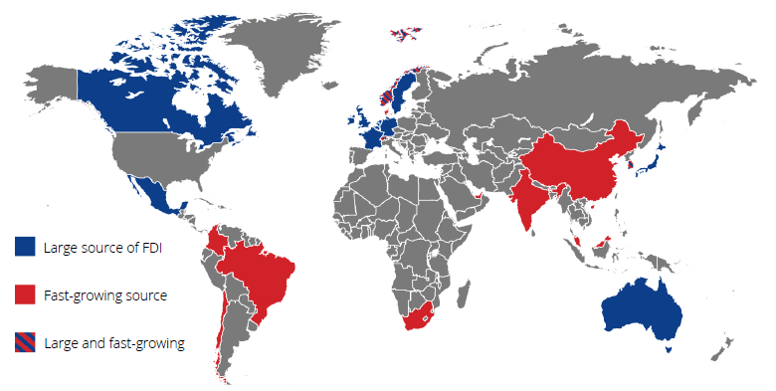
U.S. FDI Trends
Top 15 FDI Stock (2014) and Growth Markets, 2009-2014 CAGR
11
FDI Position by Ultimate Beneficiary Owner
Source: Department of Commerce, Bureau of Economic Analysis
Notes:
Note: The top sources of inward FDI FLOWS into the U.S. in 2014 came from the Netherlands ($38.9 billion), followed by Japan ($33.8 billion), Switzerland ($23.5 billion), Canada ($21.1 billion), and Germany ($19.1 billion).

Slide 12
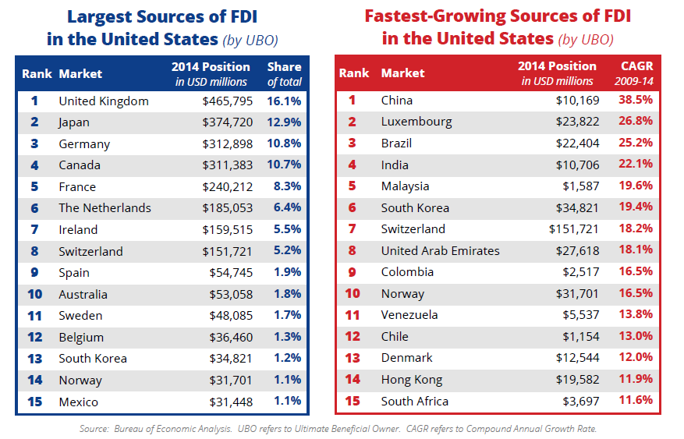
Largest and Fastest Growing
Top 15 FDI Stock (2014) and Growth Markets, 2009-2014 CAGR
Source: Department of Commerce, Bureau of Economic Analysis
Notes:
[Linking Trade and Investment: Education on the Sources of the Largest and Fastest Growing FDI in the U.S.]

Slide 13
FDI in the United States by Industry
2014 Largest Recipients by Position
13
Source: Department of Commerce, Bureau of Economic Analysis,
Notes:
[Industry Breakdown of total U.S. FDI Stock]
Note: Value is in millions of USD ($)
Manufacturing is the largest recipient of FDI in the United States, accounting for more than one-third of total position.
Finance & Insurance and Banking are the second largest recipients, accounting for about 20 percent of total FDI position.
Other industries include agriculture and forestry, mining, utilities, construction, transportation & warehousing, and more. By value, the largest industries in this aggregation are mining, nonbank holding companies, and utilities.
Official data on FDI in the United States now showcases real estate and rental/leasing as an independent category, accounting for two percent of total position.

Slide 14
FDI in the United States by Industry
Growth in Selected Sectors, 2009 - 2014
14
Source: Department of Commerce, Bureau of Economic Analysis

Slide 15
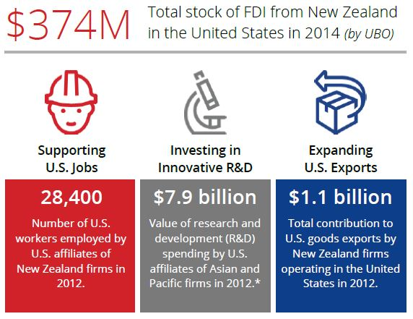
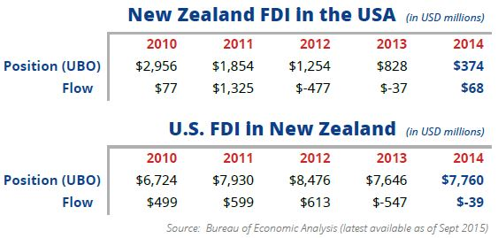
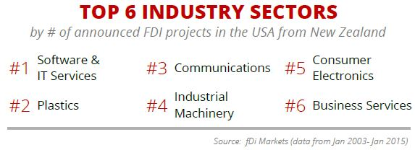
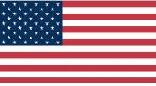
FDI From New Zealand
Source: Department of Commerce, Bureau of Economic Analysis
Notes:
fDiMarkets.com:
No. of Projects 17
Total Job creation 537
Total Capital Investment $142.40 m
Top Sectors:
Software & IT Services
Industrial Machinery, Equipment & Tools
Elit Avia – May 2013 – Slovenia-based executive airline operator open a new sales office in Atlanta, GA. This $2.3m investment created 46 new jobs
NNG (Nav N Go) – April 2015 – Hungary-based developer of 3D satellite navigation and mobile applications opened a new office in Birmingham, MI. This $5.40m investment created 38 new jobs.
Bervina – Sept 2014 – Hungary-based manufacturer or power transmission components opened a new office in Michigan. This $5.30m investment created 19 new jobs.
Repsly – June 2014 – Croatia-based software service company specilizing in managing company field activity relocated its headquarters to Boston, MA.
Gravity – Rock Solid Recommendations – Sept 2011 – Hungary-based recommedation system developer established an office in New York. This $9.40m investment created 37 new jobs.
Zetor – Nov 2012 – Subsidiary of Slovakia-based HTC Holding is a tractor manufacturer that relocated from Harrisburg, PA to Jacksonville, FL. This $1.40m investment created 10 new jobs.

Slide 16
SelectUSA Services
Notes:
SelectUSA Services Transition Page

Slide 17
How SelectUSA Can Help
SelectUSA Services for Firms
Information, Research & Counseling on business investment in the United States and developing an FDI strategy.
Ombudsman Assistance to help with questions or concerns about U.S. federal rules and regulations.
In-Market Investment Promotion for EDOs to market their locations to targeted investor audiences
Notes:
Information and Counseling: We provide subject-matter expertise to companies and EDOs on business investment in the United States and developing an FDI strategy.
In-Market Investment Promotion: Fee-based platforms for EDOs to market their locations to targeted investor audiences. We offer facilitated investment missions (FIMs) and organize Single Location Promotion (SLP) programs.
Ombudsman Assistance*: We help companies and EDOs with questions or concerns about U.S. federal rules and regulations.
Advocacy*: For EDOs facing international competition on investment projects by engaging support from high-profile U.S. Government officials.

Slide 18
State, Local, & Regional EDOs
State
Regional
Local
Notes:
Information and Counseling: We provide subject-matter expertise to companies and EDOs on business investment in the United States and developing an FDI strategy.
In-Market Investment Promotion: Fee-based platforms for EDOs to market their locations to targeted investor audiences. We offer facilitated investment missions (FIMs) and organize Single Location Promotion (SLP) programs.
Ombudsman Assistance*: We help companies and EDOs with questions or concerns about U.S. federal rules and regulations.
Advocacy*: For EDOs facing international competition on investment projects by engaging support from high-profile U.S. Government officials.

Slide 19
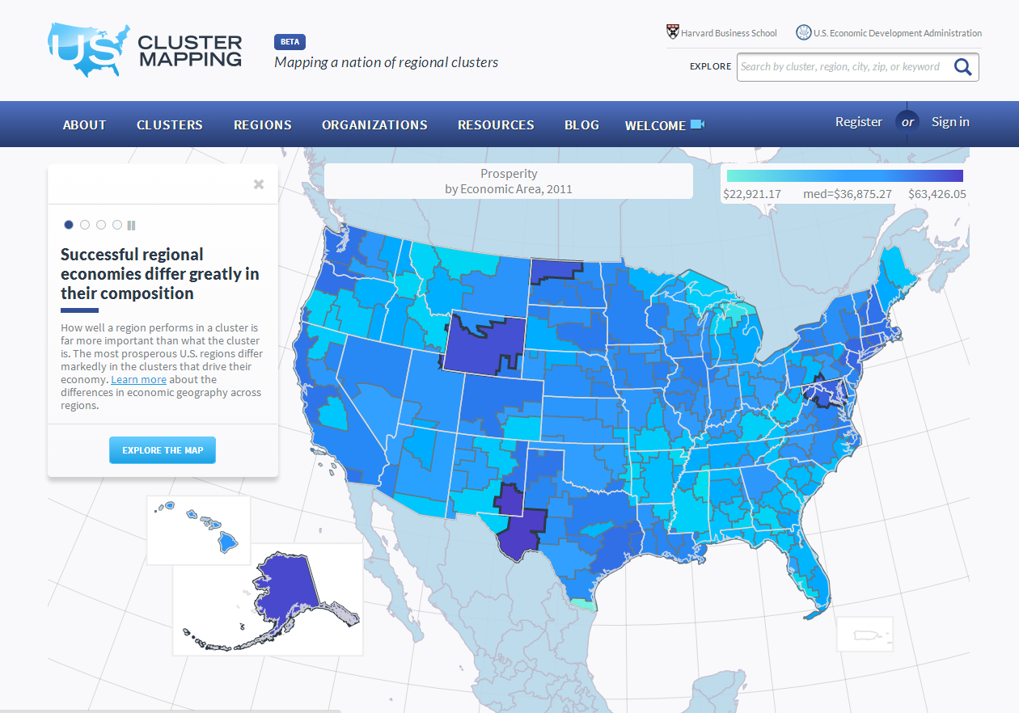
Info Tools: ClusterMapping.us
Interactive database with over 50 million open data records on industry clusters and sub-clusters.
Comparable at the State, Economic Area, MSA or county level.
Also includes the cluster registry.
Notes:
Cluster Mapping Tools, provides data on regional clusters and economies to support businesses.)

Slide 20
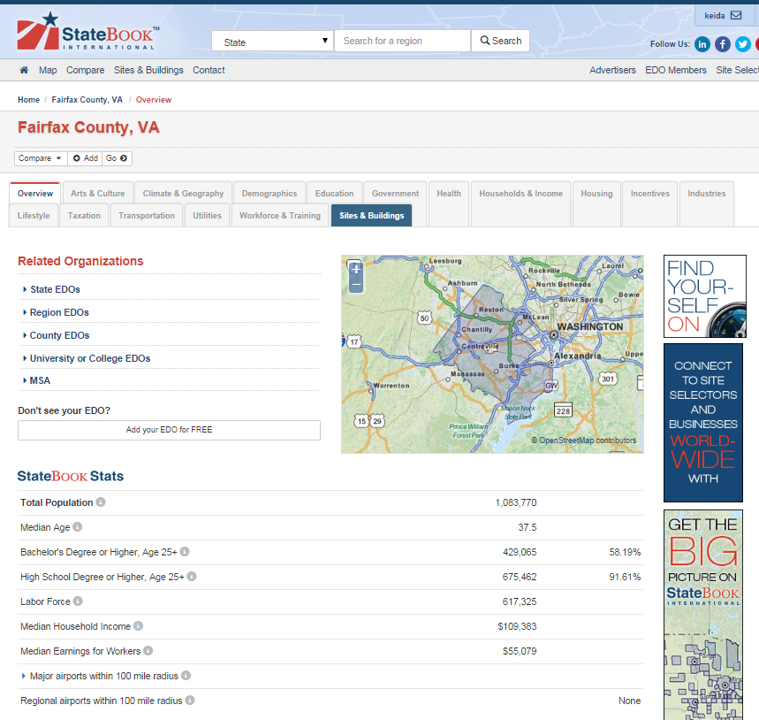
Info Tools: Statebook
More than 20,000 data points on U.S. communities, with a powerful map and ability to compare locations.
Notes:
About Statebook.

Slide 21
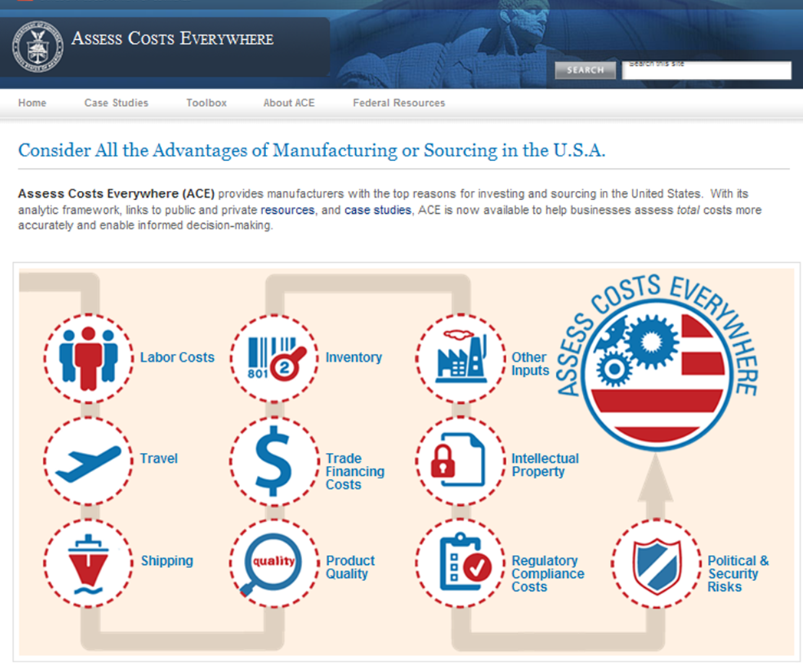
Manufacturing Tools and Info
Notes:
About Statebook.

Slide 22
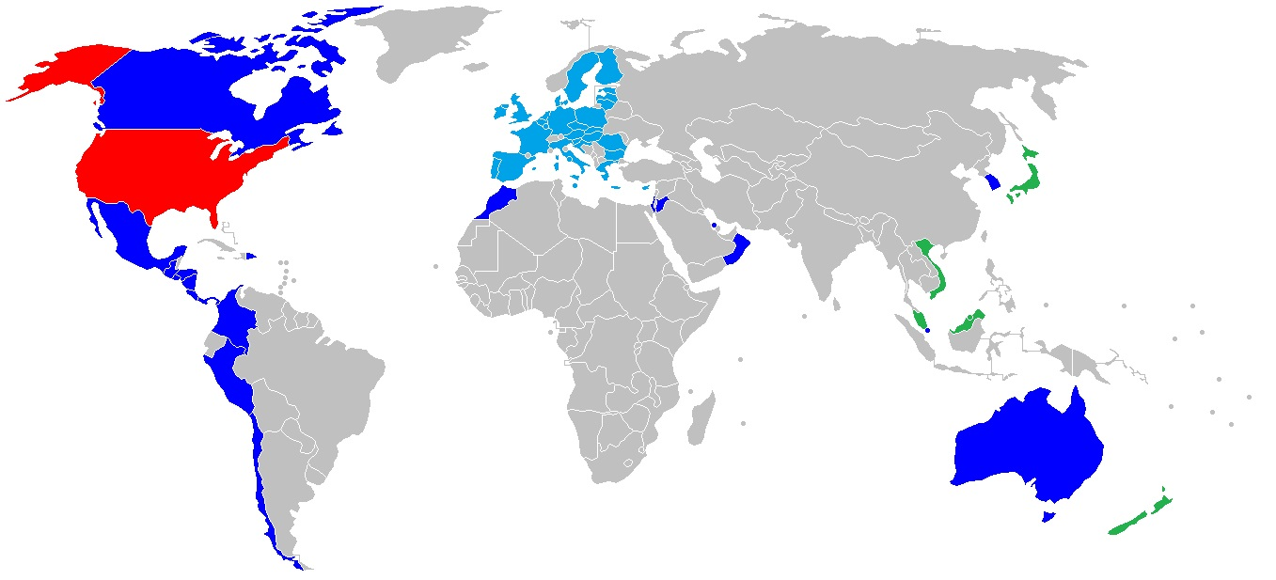
U.S. Free Trade Agreements & FTZ
22
The United States has Implemented or Entered into Force 19 Free Trade Agreements – With a Combined Population of Over 740 Million Consumers
U.S. Free Trade Agreements²
Year Entered into Force | FTA Signatory Markets | Signatory’s 2012 Nominal GDP* (million USD)
1985 | Israel | 240,900
1994 | NAFTA: Canada, Mexico, United States | 2,376,000
2004 | Chile | 268,200
2004 | Singapore | 276,500
2005 | Australia | 1,542,000
2006 | Bahrain | 27,030
2006 | Morocco | 97,530
2007 | Peru | 199,000
2009 | CAFTA – DR: Costa Rica, El Salvador, Guatemala, Honduras, Nicaragua, Dominican Republic, United States | 206,730
2009 | Oman | 76,460
2010 | Jordan | 31,210
2011 | Colombia | 366,000
2011 | Panama | 36,250
2012 | South Korea | 1,156,000
Proposed: TPP | Australia, Brunei, Canada, Chile, Japan, Malaysia, Mexico, New Zealand, Peru, Singapore, United States, Vietnam | 11,873,630
Proposed: TTIP | European Union and United States | 16,417,100
*U.S. nominal GDP was $15.7 trillion in 2012¹
Sources:¹CIA World Factbook, ²Office of the U.S. Trade Representative
Notes:
Note: The top sources of inward FDI FLOWS into the U.S. in 2014 came from the Netherlands ($38.9 billion), followed by Japan ($33.8 billion), Switzerland ($23.5 billion), Canada ($21.1 billion), and Germany ($19.1 billion).

Slide 23
What Drives FDI Decisions?
Notes:
FDI Trends Transition

Slide 24
Reasons to Invest in the United States
There are many reasons to invest in the United States!
Open investment policy – with few exceptions (e.g. national security), the U.S. is open to virtually all types of foreign investment and foreign companies (not true elsewhere)
Economic growth (versus other mature markets)
Large, affluent consumer market
Access to growing markets (especially Canada and Mexico via NAFTA)
Political stability (versus other markets, esp. emerging markets)
Skilled and productive work force
Access to advanced technology and leading Research & Development institutions (the U.S. is generally regarded as the best in moving from “idea to market” / “inspiration to sale” due, in part, to close relationships between the private sector and academia)
Government policies and regulations, including incentives (in the U.S., incentives are often routed through the tax code, whereas in Europe, similar incentives often occur “up-front” in the form of subventions)
Strong protection for Intellectual Property
Abundant (often affordable) natural resources, such as oil and natural gas
Strong, diverse financial services industry (including access to capital for companies)
Historically, foreign (direct) investment [FDI] was motivated by the U.S. consumer market (320 million). That remains true today, but increasingly, FDI is motivated by other factors, including access to other markets. For example: BMW is the largest exporter of US-produced autos!

Slide 25
Recent + Upcoming Events
25
Visit http://selectusa.commerce.gov/upcoming-events for details
September 14-21 Nordics Road Show
October 13-15 India Road Show
October 26-28 Aerospace FDI Exposition
November 17 SelectUSA Canada Event
December 1-4 Brazil Road Show
April 25-29 Hannover Messe Trade Show
June 19-21 2016 SelectUSA Summit
Spring 2016 Road Shows TBD in Japan, Mexico, China + Trade Shows

Slide 26
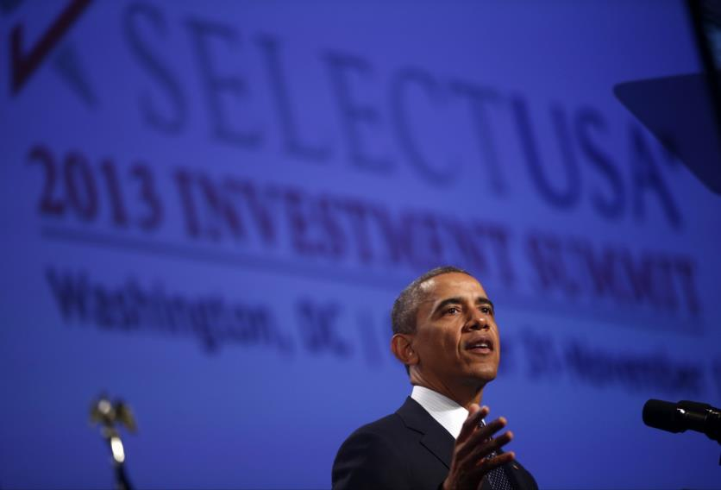
The 2015 SelectUSA Investment Summit
March 23-24, 2015
2,600+ attendees
1,300 Foreign Firm Participants led by 45 U.S. Ambassadors
All 50 U.S. States and most Territories represented
SelectUSA.gov

Slide 27
Save the date: 2016 SelectUSA Summit
June 19-21, 2016 in Washington, D.C.
At the Washington Hilton
Visit
http://selectusa.commerce.gov/2016-summit.html
for more information and email updates

Slide 28
Thank You
New Zealand Portfolio Manager:
Seth Isenberg
Senior International Investment Specialist
SelectUSA
Washington, DC USA
Office: +1 202 482 0588
Seth.Isenberg@trade.gov
In-Country Contact:
Dhiraj Mani
Commercial Specialist
U.S. Commercial Service
Auckland, New Zealand
Office: 64 (9) 3032724 x 2867
Cell: 64 (21) 2235406
Dhiraj.Mani@trade.gov
@SelectUSA & #SelectUSA on Twitter

