Slide 1

US BUSINESS IMMIGRATION BASICS
by
Ada Echetebu, J.D., LL.M.

Slide 2
Disclaimer
The views and opinions presented in today’s presentation are for educational purposes only and do not constitute legal advice. No attorney-client relationship is hereby formed.

Slide 3

Us immigration law is complex
DETAINED!!!!!
DON’T GO IT ALONE!

Slide 4
Us immigration = Federal law
SelectUSA is a federal government program designed to help you:
Promotes foreign direct investment
Coordinates with all branches of the federal government
SelectUSA representatives to help you where possible, including immigration
Makes sense!!!
Our Kiwi Clients benefit from SelectUSA support.

Slide 5
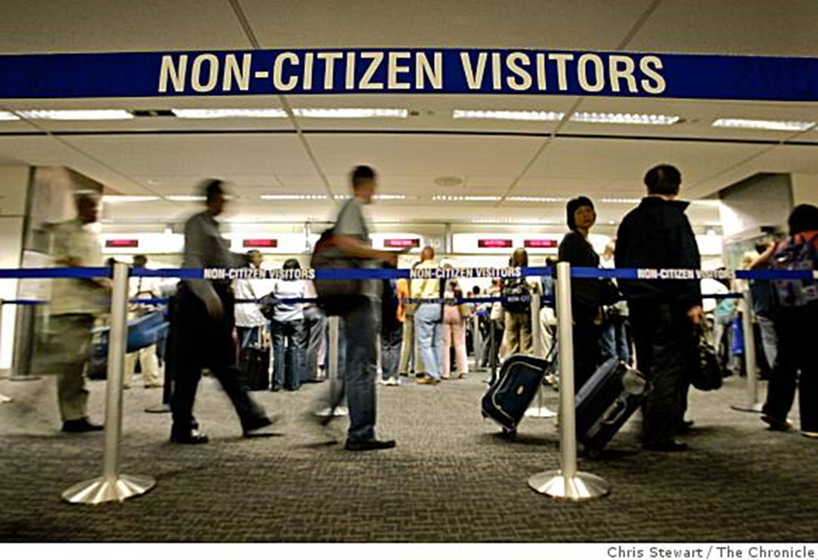
TYPE OF VISA OPTIONS AVAILABLE TO kiwi BUSINESS TRAVELERS

Slide 6
VISA WAIVER PROGRAM (“VWP”)
NO VISA REQUIRED – just the ESTA
Presumption of immigrant intent (WATCH OUT!!!!)
90 DAYS Maximum stay per trip
180 DAY Rule-of-Thumb Advice
Cannot get an ESTA if you have prior visa violations/ineligibilities
Can be used for Tourism or Business Trips.
NO WORK!!!

Slide 7
What is “business”?
Meetings
Short Educational Courses
Conventions/Conferences/Trade Shows
Negotiate Contracts
Litigate
Train
BUT!!!!!

Slide 8
Do not “work”!!
Do not:
  Go in to manage and operate the day–to-day functions of your US business
  Receive direct payment from a US entity for any action taken

Slide 9

BUSINESS VISITOR VISA (B-1)
Must apply through the Consulate
Presumption of Immigrant Intent (Watch Out!)
6 month stay (extend up to 1 year)
NO WORK!!!

Slide 10

L-1 INTRACOMPANY TRANSFEREE VISAs
Transfer a executive, manager, (L-1A) or employee with specialized knowledge(L-1B)
Transferred employee must be in same position for 1 of last 3 preceding years prior to transfer
Dual-Intent Allowed
Terms: 1 year, 3 year, 5 year
2 year extension up to 7 years total
“New Office” Option

Slide 11

SPECIALITY OCCUPATION & SKILLED/UNSKILLED WORKERS
H- VISA CATEGORIES (EX. H-1B)
MUST HAVE A US EMPLOYER
QUOTAS MAKE IT HARD TO GET

Slide 12
OTHER NON-IMMIGRANT employment-based VISAS
The O-Visa categories – extraordinary ability & achievement
Treaty-based visas for Kiwis with other Nationalities/Passports
E.g., E-3 (Australian Specialty Occupation Visa)
E.g., E-2 Treaty Investor Visas (Treaty Countries Only --e.g., The Netherlands)
NOT NEW ZEALAND…

Slide 13
IMMIGRANT VISAS
I.E., GREEN CARD!!!!
Immediate Relative-Sponsored
  Spouse, unmarried child under 21, Parent of a USC over 21
Family Preference Immigrant Visas
  Limited number– unmarried children of USC; spouses and children of Lawful Permanent Residents (LPRs); siblings
Employment-Based Immigrant Visas
  Transition to permanent residency from dual-intent employment visas (ex. L-1A)
  Investor Visas (EB-5)

Slide 14

EB-5 INVESTOR VISA
Purpose to stimulate the US economy and create jobs—average10k granted/yr
$1 Million USD/$500K USD (Targeted Employment Areas) “at risk” capital investment
New Commercial Enterprise
Employs 10 full-time US Workers
Regional Centers
SELECTUSA VERY HELPFUL!!!!!
Conditional LPR, transition to Green Card

Slide 15
Tel: 09-889-2602
Zachary D Norris: zdnorris@nz-uslegal.co.nz
Ada Echetebu: aechetebu@nz-uslegal.co.nz

